Slide 1

CARELENS
Bridging the Gap Between Medical Paperwork and Human Understanding
Your AI-powered personal health copilot
TEAM NAME · TEAM LEAD · MEMBER 1 · MEMBER 2 · MEMBER 3 · MEMBER 4

Slide 2

The Paper Maze of Indian Healthcare
78%
of medical records remain on paper
WhatsApp photos become the patient record
Illegible handwriting creates confusion
Unclear information amplifies medical anxiety

Slide 3

Why Patients Suffer
Paperwork becomes fear when no one translates the meaning.
Complex numbers
Elderly parents struggle to interpret reports.
300,000+ brands
Medicine choice becomes overwhelming.
High ≠ hopeless

Slide 4
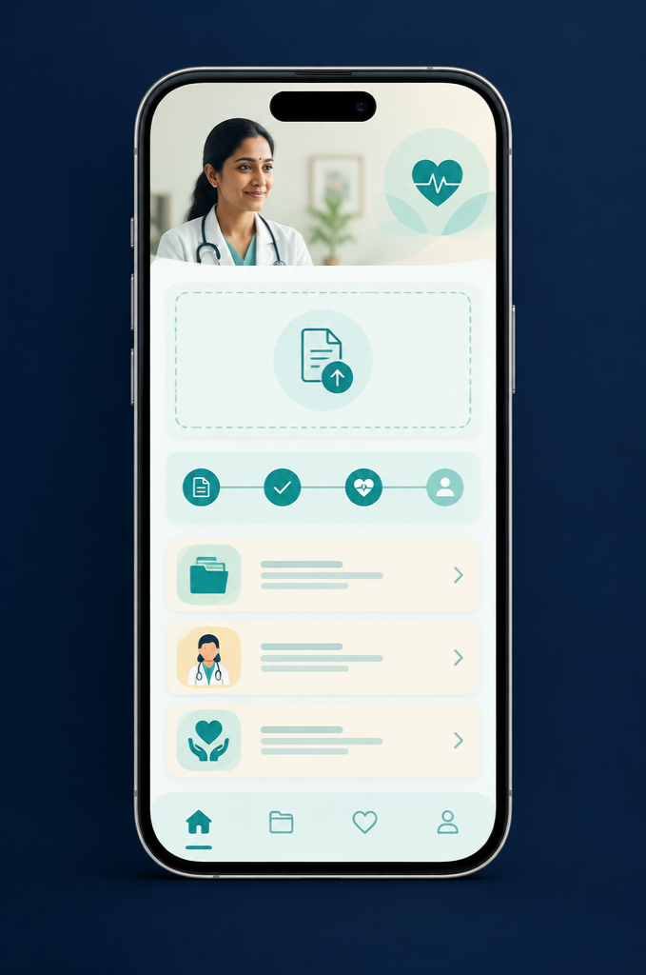
Your 24/7 Personal Health Copilot
From document to understanding—in moments.
01
UPLOAD
Any prescription or blood test
02
UNDERSTAND
Plain-language guidance you can act on

Slide 5
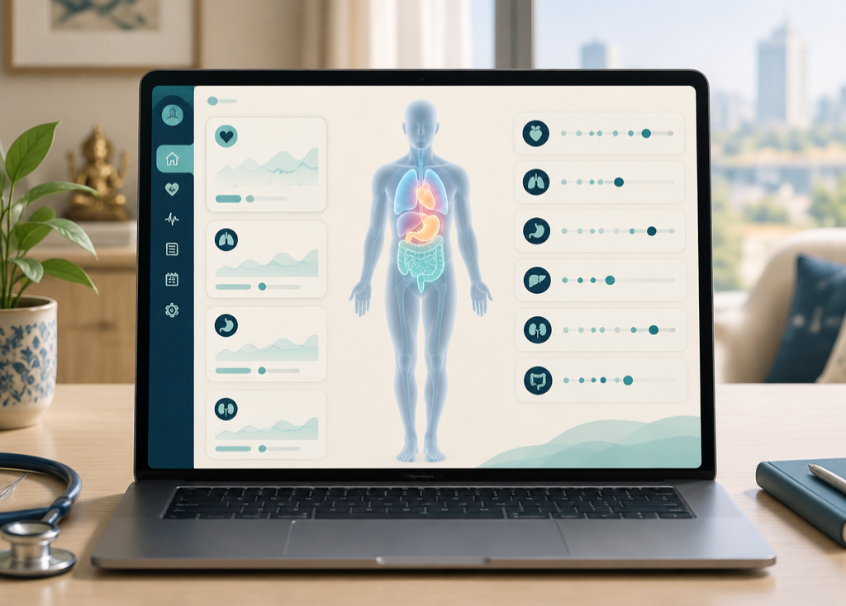
Health Made Visual, Not Intimidating
See what your numbers mean.
3D Body Twin
Health data mapped to the body—not buried in a table.
Dot-sliders
Normal, watch, and act ranges at a glance.

Slide 6
How a Document Turns Into Clarity
A safeguarded pipeline—simple for patients, rigorous underneath.
01
02
03
04
Upload & Clean
Privacy Shield
Smart Reading
Medical Verification
Digitize and prepare documents
Protect patient data securely
AI parses and understands text
Expert review ensures accuracy

Slide 7
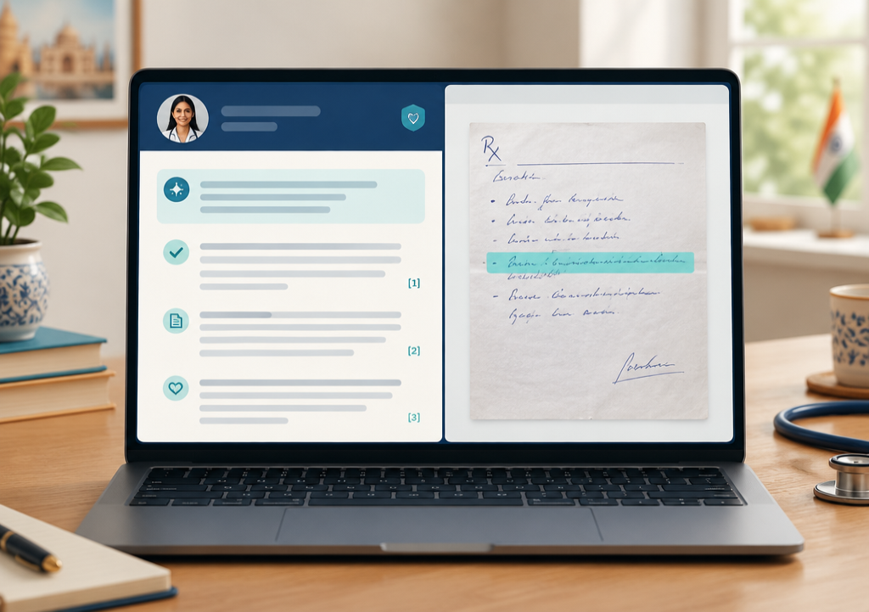
Every AI Claim Has a Receipt
Click an explanation.
CareLens highlights the exact sentence on the original document—so understanding never asks for blind trust.
SPLIT-SCREEN VERIFICATION
SOURCE VERIFIED

Slide 8
Why You Can Trust CareLens
Deterministic rule engine
ZERO
GUESSWORK
Checks normal vs abnormal values against explicit rules.
Guide, never prescribe
SAFE
We never guess. We explain safely and direct patients to qualified care.

Slide 9
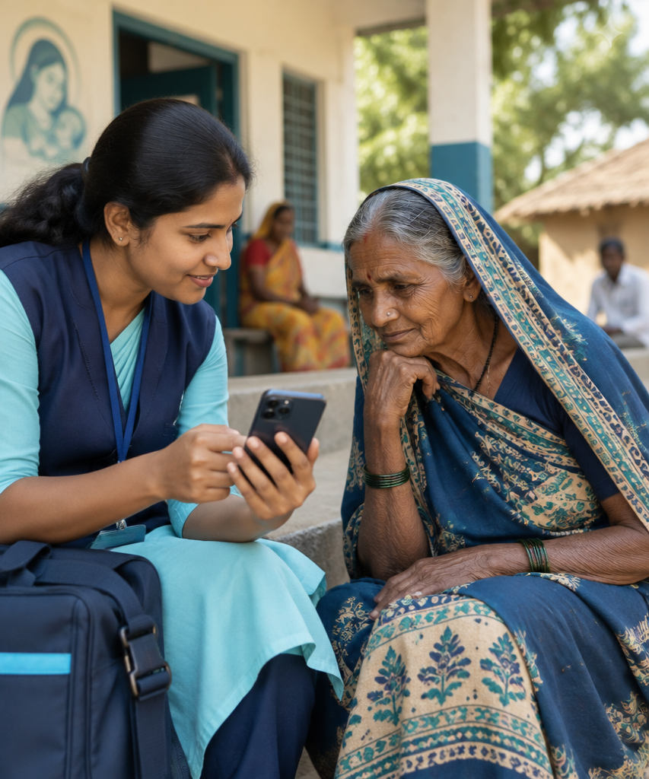
Democratizing Health for Every Indian
Understanding should never depend on English literacy.
తెలుగులో స్పష్టత
हिंदी में स्पष्टता
Audio playback for elderly and rural users

Slide 10
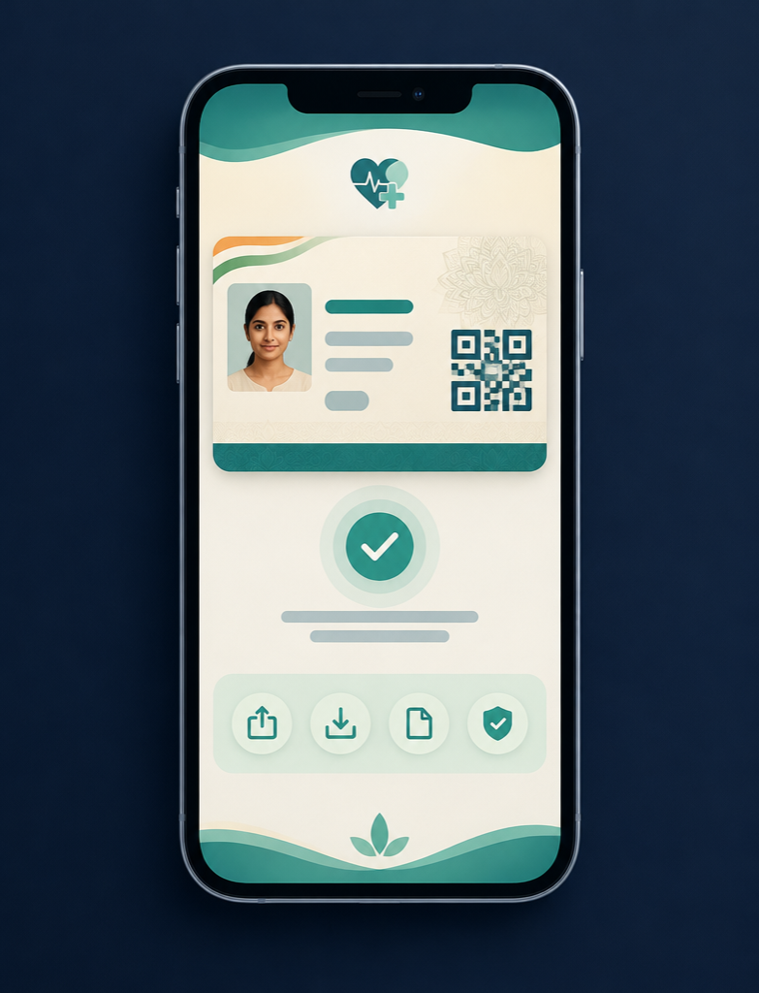
One Health Record For Life
Portable. Shareable. Standards-ready.
ABHA Digital Card
QR-enabled access for instant sharing.
ABDM FHIR export
One click to interoperable government standards.

Slide 11


From City Clinics to Rural Villages
ANY SMARTPHONE
INSTANT RESPONSE
PRIVACY FIRST
No special hardware
Zero-latency cloud
Patient rights respected

Slide 12
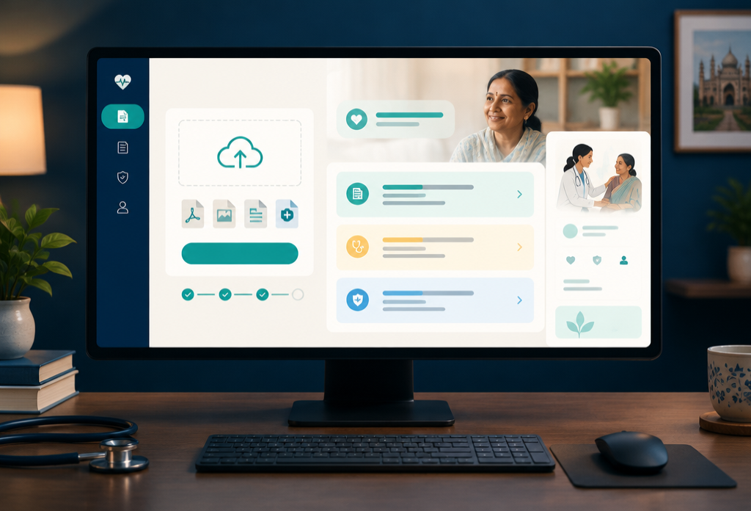
CareLens in Action
Live System Walkthrough
WATCH THE PAPER BECOME CLARITY

Slide 13

Empowering 1.4 Billion People with Clarity and Care
Thank you. Questions?
TEAM NAME · hello@carelens.health

